Slide 1
The Structural Simulation Toolkit (SST)
Presented by: Scott Hemmert and Gwen Voskuilen, Sandia National Laboratories
Content by: SST Team
SAND2023-

Slide 2
References
Websites
  Information on installing SST, and links to everything else you see here
    http://www.sst-simulator.org/
  Documentation on SST’s key interfaces, overview of all the elements, and more!
    http://sst-simulator.org/sst-docs/
  Code
    https://github.com/sstsimulator
Important Pages
Configuration File Format: http://sst-simulator.org/SSTPages/SSTUserPythonFileFormat/
Doxygen Documentation: http://sst-simulator.org/SSTDoxygen/13.1.0_docs/html/
Developer FAQ: http://sst-simulator.org/SSTPages/SSTTopDocDeveloperInfo/
Building SST
  Quick start: http://sst-simulator.org/SSTPages/SSTBuildAndInstall_13dot1dot0_SeriesQuickStart/
  Detailed: http://sst-simulator.org/SSTPages/SSTBuildAndInstall_13dot1dot0_SeriesDetailedBuildInstructions/

Slide 3

Motivation: Interoperability
There is a rich selection of open-source simulators
But not a solid ecosystem for modeling systems
  Tightly-entangled components make modifications complex
    E.g., assumptions about caching or address mapping are pervasive
  Most simulator integrations are ad-hoc, not lasting
  Significant performance problems with tying many simulators together
Wants:
  Enable “mix-and-match” of existing models to create custom systems
  Encourage disentangled models with clean interfaces for swapping functionality
    Bricks not buildings
  Low effort, high performance parallel simulation
  Continuous path from low-fidelity/fast modeling to high-fidelity/slow models

Slide 4



The Structural Simulation Toolkit
Goals
Create a standard architectural simulation framework for HPC*
Ability to evaluate future systems on DOE/DOD workloads
Use supercomputers to design supercomputers
Status
Parallel framework (SST Core)
Integrated libraries of components (Elements)
Current Release (13.1.0)
  Two releases per year
Consortium
“Best of Breed” simulation suite
Used in industry, academia, and at labs
Technical Approach
Parallel Discrete Event core
  With conservative optimization over MPI/Threads
Interoperability
  Node and system-scale models
Multi-scale
  Detailed (~cycle) and simple models that interoperate
Open
    Open Core, non-viral, modular

Slide 5
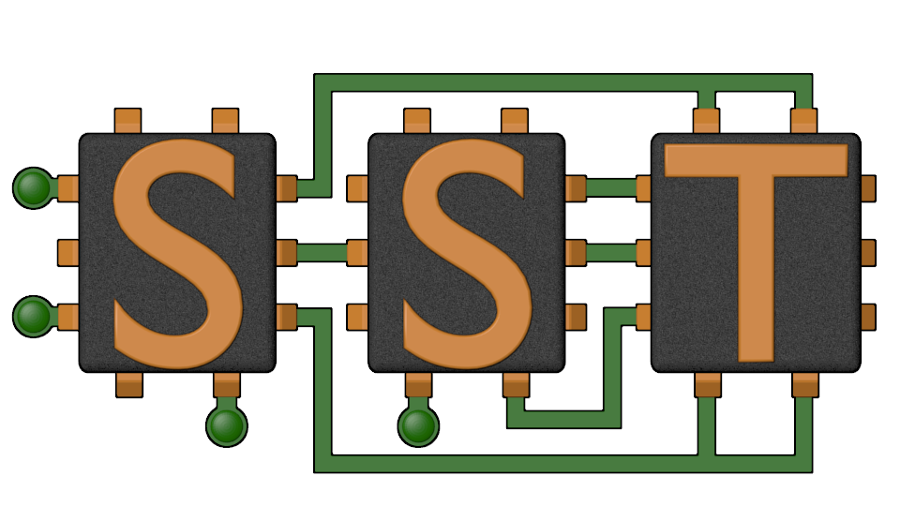
The SST Approach
Parallel Discrete-Event Simulator Framework (SST Core)
  Flexible framework enables multitude of custom “simulators”
  Demonstrated scaling to over 512 processors running a million+ components
Comes with many built-in simulation models (SST Elements)
  Processors, memories, networks
Open API
  Easily extensible with new models
  Modular framework
  Open-source core
Time-scale independent core
  Handles Micro-, Meso-, Macro-scale simulations
C++, Python

Slide 6
SST Architecture
SST Core framework
  The backbone of simulation
  Provides utilities and interfaces for simulation components (models)
    Clocks, event exchange, statistics and parameter management, parallelism support, etc.
SST Element libraries
  Libraries of components that perform the actual simulation
  Elements include processors, memory, network, etc.
    Includes many existing simulators: DRAMSim2, Spike, HMCSim, Ramulator, etc.
Component
Component
Component
Component
Processor
Cache
DRAM
NoC
Integration Services
Links, Clocks, etc.
SST Core
SST Core
MPI and C++ Threads
MPI and C++ Threads

Slide 7
High-level View

Slide 8
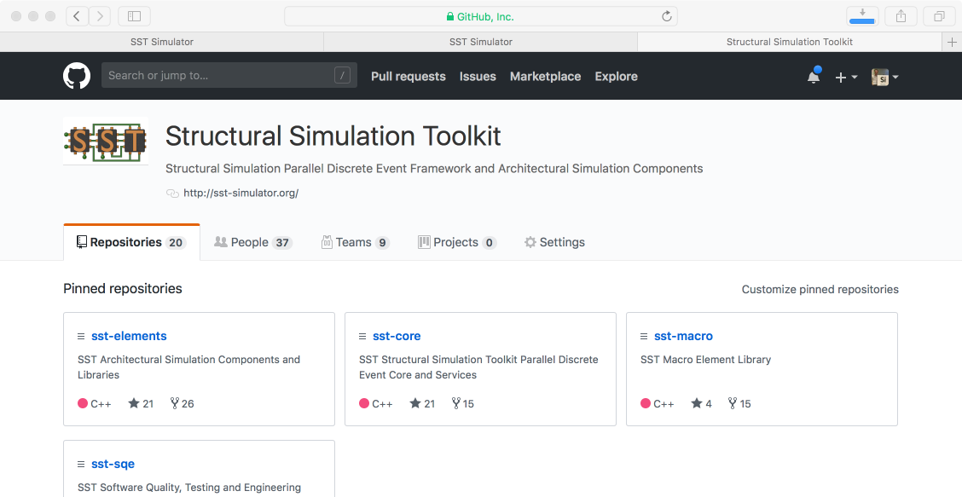
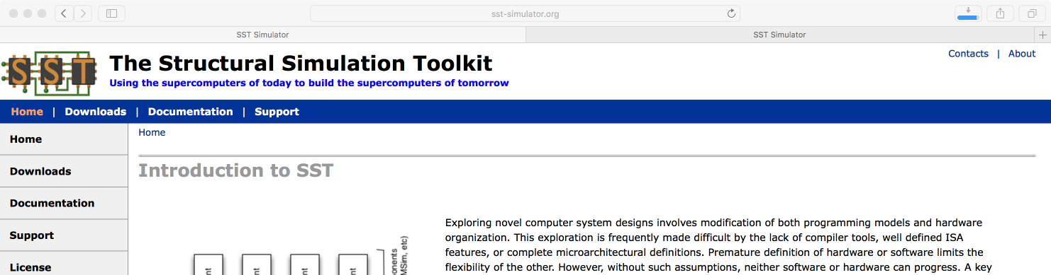
Getting and Installing SST
http://www.sst-simulator.org
  Current release source download
  Detailed build instructions including dependencies for Linux & Mac
  Archived tutorial materials
https://github.com/sstsimulator
  Source code checkout
  Master branch – has passed testing
  Devel branch – has passed basic testing

Slide 9
Building Blocks
SST simulations are comprised of components
Components are connected by links
  Every link has a minimum (non-zero) latency
  Components define ports which are valid connection points for a link
Components communicate by sending events over the links
Components can use subcomponents and modules for customizable functionality
Component
Core
Component
Core
Event
Load
Link
Link
Component
Cache
Component
Cache
Event
Data
SubComponent
Prefetcher
Link
Link
Component
NoC Router
Component
NoC Router
Link
Element Library
A collection of components, subcomponents, and/or modules

Slide 10

SST Code Structure
SST Core and SST Elements are compiled separately
  Element libraries register with the core
  External elements (not part of SST Elements) can also be registered with the core
    Example at github.com/sstsimulator/sst-external-element
  Core maintains a database of registered libraries
    Can query database with sst-info utility
Source code for core:
  sst-core/src/sst/core/
Source code for elements
  sst-elements/src/sst/elements/
  Most elements have a tests/ directory
    sst-elements/src/sst/elements/SomeComponent/tests
    Often a good starting point for example configurations
Component
Component
Component
Component
Integration Services
SST Core
MPI and C++ Threads

Slide 11
Our First Simulation – demo_1.py
Simulated System
We’ll walk through how to configure a simulation and then run it
  Available at: https://github.com/sstsimulator/sst-tutorials/tree/master/hpca2024/exercises
  ( github → sstsimulator → sst-tutorials → hpca2024 )
Element libraries in our example simulation
  Miranda - Simple core model that runs generated instruction streams
    Generators produce memory access patterns (SubComponent)
  memHierarchy – Various cache/memory system related subcomponents and modules
    Cache (Component) with coherence protocol SubComponent
    Memory Controller (Component) that loads a memory timing model (SubComponent)
gen
core
cache
memory
memctrl
These names match the variables in demo_1.py

Slide 12
Configuration File: Global SST parameters
Set any global simulation parameters
Other options
  Most command line options to SST are able to be set using setProgramOption()
import sst
##########################
## Define SST core options
##########################
# If this demo gets to 100ms, something
# has gone very wrong!
sst.setProgramOption("stop-at", "100ms")
SST Python API
User-defined string
SST argument
Option | Definition
debug-file | File to print debug output to
heartbeat-period | If set, SST will print a heartbeat message at the specified period
print-timing-info | Tells SST to print timing information from the run
partitioner | Partitioner to use for parallel execution
output-partition | File to print partition to

Slide 13
Configuration File: Declare components
SST Python API
User-defined string
SST argument
Components: sst.Component(“name”, “type”)
gen
######################
## Declare components
######################
core = sst.Component(“core”, “miranda.BaseCPU”)
cache = sst.Component(“cache”, “memHierarchy.Cache”)
memctrl = sst.Component(“memory”, “memHierarchy.MemController”)
core
cache
memctrl
mem
Component name
Element library

Slide 14

Configuration File: Configure the core
SST Python API
User-defined string
SST argument
Parameters: addParams({ “parameter” : “value”, … })
########################################################
## Set component parameters and fill subcomponent slots
########################################################
core.addParams({
"clock" : "2.4GHz",
"max_reqs_cycle" : 2,
})
gen
core
cache
memctrl
mem
How do I know what the options are?
Or even what elements I can pick from?
sst-info

Slide 15
Aside: sst-info
Use sst-info to find information about all registered elements.
$ sst-info miranda.baseCPU
PROCESSED 1 .so (SST ELEMENT) FILES FOUND IN DIRECTORY(s)
[...]
================================================================================
ELEMENT LIBRARY 0 = miranda ()
Components (1 total)
Component 0: BaseCPU
Description: Creates a base Miranda CPU ready to execute an address generator/access pattern
ELI version: 0.9.0
Compiled on: Dec 1 2023 14:33:14, using file: mirandaCPU.h
Category: PROCESSOR COMPONENT
Parameters (12 total)
max_reqs_cycle: Maximum number of requests the CPU can issue per cycle
(this is for all reads and writes) [2]
...

Slide 16
Configuration File: Add a subcomponent
SST Python API
User-defined string
SST argument
SubComponents: setSubComponent(“slotname”, “type”)
  Recall: SubComponent is a swappable piece of functionality
gen
gen = core.setSubComponent("generator", "miranda.STREAMBenchGenerator")
gen.addParams({
"n" : 1000, # Number of array elements
})
core
cache
memctrl
mem

Slide 17
Configuration File: Configure the cache
SST Python API
User-defined string
SST argument
cache.addParams({
"L1" : 1,
"cache_frequency" : "2.4GHz",
"access_latency_cycles" : 2,
"cache_size" : "2KiB",
"associativity" : 4,
"replacement_policy" : "lru",
"coherence_policy" : "MESI",
"cache_line_size" : 64,
})
gen
core
cache
memctrl
mem

Slide 18
Configuration File: Configure the memory controller
SST Python API
User-defined string
SST argument
memctrl.addParams({
"clock" : "1GHz",
"backing" : "none", # No real memory values, just addresses
"addr_range_end" : 1024*1024*1024-1,
})
memory = memctrl.setSubComponent("backend", "memHierarchy.simpleMem")
memory.addParams({
"mem_size" : "1GiB",
"access_time" : "50ns",
})
gen
core
cache
memctrl
mem

Slide 19
Configuration File: Declare and connect
Links: sst.Link(“name”)
#######################################
## Declare links
#######################################
core_cache = sst.Link("core_to_cache")
cache_mem = sst.Link("cache_to_memory")
########################################
## Connect components with the links
########################################
core_cache.connect( (core, "cache_link", "100ps"),
(cache, "high_network_0", "100ps") )
cache_mem.connect( (cache, "low_network_0", "100ps"),
(memctrl, "direct_link", "100ps") )
gen
core
Link name
cache
memctrl
mem

Slide 20
Configuration File: Connect links
Connect components: connect(endpoint1, endpoint2)
  Where endpoint is: (component, port, latency)
gen
########################################
## Connect components with the links
########################################
core_cache.connect( (core, "cache_link", "100ps"),
(cache, "high_network_0", "100ps") )
cache_mem.connect( (cache, "low_network_0", "100ps"),
(memctrl, "direct_link", "100ps") )
core
Endpoint 1
cache
Endpoint 2
memctrl
mem
How do I remember the port names?

Slide 21
SSTInfo: Getting component info
sst-info: utility to query element libraries
Optionally filter for a specific library and/or component
$ sst-info memHierarchy.Cache
PROCESSED 1 .so (SST ELEMENT) FILES FOUND IN DIRECTORY(s) /home/sst/build/lib/sst
Filtering output on Element = “memHierarchy.Cache”
================================================================================
ELEMENT LIBRARY 0 = memHierarchy ()
Component 2: Cache
Description: Cache controller
Parameters (41 total)
cache_frequency: (string) Clock frequency or period with units (Hz or s; SI units OK) [<required>]
cache_line_size: (uint) Size of a cache line (aka cache block) in bytes. [64]
…
Ports (10 total)
low_network_0: Port connected to lower level caches (closer to main memory)
…
Statistics (43 total)
TotalEventsReceived: Total number of events received, (units = "events") Enable level = 1
…
“REQUIRED” or default value
Parameter
Definition
Port name
Definition
Name
Definition
Units
Enable Level

Slide 22
Running SST
Usage: sst [options] configFile.py
Common options:
-h | --help | Print complete list of command line options
-v | --verbose | Print information about core runtime
--debug-file <filename> | Send debugging output to specified file (default: sst_output)
--partitioner <self | simple | rrobin | linear | lib.partitioner_name> | Specify the partitioning mechanism for parallel runs
-n | --num_threads <num> | Specify number of threads per rank
--model-options “<args>” | Command line arguments to send to the Python configuration file. Any arguments after a final – will be appended to the model-options.
--output-partition <filename> | Write partitioning information to <filename>
--output-dot <filename> --output-xml <filename> --output-json <filename> | Output the configuration graph in various formats to <filename>
Notes:
Is this still up to date?

Slide 23
Running a simulation
Launch simulation
Output
We probably want more information about what happened though
  Enable statistics!
$ sst demo_1.py
Simulation is complete, simulated time: 6.80711 us

Slide 24
Enabling statistics
Most Components and SubComponents define statistics
Enable statistics in the configuration file
  enableAllStatisticsForAllComponents()
  enableAllStatisticsForComponentType(type)
  enableAllStatisticsForComponentName(name)
  setStatisticLoadLevel(level)
Configure output
  setStatisticOutput(“sst.output_type”)
  setStatisticOutputOptions({“option” : “value”, })
$ sst-info memHierarchy.Cache
…
Statistics (43 total)
TotalEventsReceived: Total number of events received, (units = "events") Enable level = 1
CacheHits: Total number of cache hits, (units = count) Enable Level = 1
latency_GetS_hit: Latency for read hits, (units = cycles) Enable level = 1
  enableStatisticForComponentName(name, stat)
  enableStatisticForComponentType(type, stat)

Slide 25
Running with statistics enabled
Let’s enable statistics for all components
  Caches have A LOT of statistics so send the output to a CSV file
  Other options: sst.statoutputX where X=
    console
    json
    txt
    hdf5
sst.setStatisticOutput(“sst.statoutputcsv”)
sst.setStatisticOutputOptions({ “filepath” : “stats.csv” })
sst.setStatisticLoadLevel(5)
sst.enableAllStatisticsForAllComponents()

Slide 26
Running a Simulation – Add Statistics
Copy configuration
Add statistics to new configuration
Launch simulation
Take a minute to look at the statistics
  Can you calculate the L1 memory bandwidth?
$ cp demo_1.py demo_2.py
What should you add?
$ sst demo_2.py

Slide 27
SST in parallel
MPI Rank 0
Comp0
Comp2
Comp4
Comp6
SST was designed from the ground up to enable
scalable, parallel simulations
Components distributed among MPI ranks/threads
  Link latency controls synchronization rate
Comp1
Comp3
Comp5
Comp7
# Two ranks
$ mpirun –np 2 sst demo1.py
# Two threads
$ sst –n 2 demo1.py
# Two ranks with two threads each
# This will give a warning since we only
# have 3 components across 4 ranks/threads
$ mpirun –np 2 sst –n 2 demo1.py
Same configuration file
MPI Rank 0
MPI Rank 1
MPI Rank 2
MPI Rank 3
Comp0
Comp2
Comp4
Comp6
Comp1
Comp3
Comp5
Comp7
Notes:
Links handle serialization

Slide 28
A Tour of SST Elements

Slide 29

SST Element Libraries
Elements are libraries of related components
  Elements must be registered with the SST core
    Tells SST where to find this set of components
    Includes information on parameters and statistics for each component
SST provides a set of element libraries
  Processor, network, memory, etc.
  Tested for interoperability within and across libraries
  Many are compatible with external “components” such as Ramulator and Spike
You can also register your own elements
  Example: https://github.com/sstsimulator/sst-external-element

Slide 30
(A few) SST 13.1 Elements
Processors
  Ariel – PIN-based
  Prospero – trace execution
  Miranda – pattern generator
  Vanadis – MIPS32 and RV64 pipeline
  GeNSA – Spiking temporal processing unit
  Osseous – RTL simulation
Memory Subsystem
  MemHierarchy – caches, directory, memory
  CacheTracer – cache tracing
  Cassini – cache prefetchers
  CramSim – DDR, HBM
  Messier – NVM
  Samba – TLB
  VaultSim – vaulted stacked memory
Network drivers
  Ember – communication patterns
  Firefly – communication protocols
  Hermes – MPI-like driver interface
  Zodiac – trace based driver
  Thornhill – memory models for Ember
Networks/NoCs
  Merlin – flexible network modeling
  Kingsley – mesh NoC
  Shogun – crossbar NoC
Accelerators
  Balar – GPGPU-Sim interface
  Llyr – spatial compute
Others
  sst-macro → Mercury
  simpleElementExample
  simpleSimulation

Slide 31
Processor Models
Elements:
Ariel
Prospero
Miranda
Vanadis

Slide 32
Ariel: PIN-based processor
$ sst-info ariel.ariel
Lightweight processor core model
Uses Intel’s PIN tools and XED decoders to analyze binaries
  Runs x86, x86-64, SSE/AVX, etc. binaries
  Supports fixed thread count parallelism (OpenMP, Qthreads, etc.)
Passes instructions to virtual core in SST
Pin
x86 Binary
Binary
Instruction
trace
Ariel CPU
SST
Core
Core
Core
Core
Processor
Memory
Network/NoC
Network driver
Other

Slide 33
Ariel: Details
$ sst-info ariel.ariel
Pintool communicates with Ariel via shared memory IPC
  Per-thread FIFO of instructions from pintool to Ariel’s virtual cores
  Backpressure on FIFO halts the binary’s execution
Ariel’s virtual cores
  Memory instruction oriented: execute memory instructions; other ins. single cycle no-ops
  Clocked: Reads instruction stream in chunks but processes on clock
  Does not maintain dependence order or register locations
  Can map virtual-to-physical addresses internally or use external component
Key parameters
  Ops issued/cycle
  Load/store queue size
Uses SST standardMem interface
  Generates StandardMemRequests
  Compatible with memHierarchy
Processor
Memory
Network/NoC
Network driver
Other

Slide 34
Ariel: The Tradeoff
$ sst-info ariel.ariel
Pros:
  Faster than more complex/pipeline models
  Reasonable approximation for studies on memory system performance
    Especially for heavily memory-bound applications
  Reasonable model of thread interactions
Cons
  Non-deterministic results
    Interactions between pintool, threads, etc.
    Variation is low (O(1%))
  Not compatible with non-x86 binaries
  Reliant on Pin
    Ongoing work to enable other frontends
Processor
Memory
Network/NoC
Network driver
Other

Slide 35
Prospero: Trace-based processor
$ sst-info prospero.prosperoCPU
Trace-based processor model
  Like Ariel, memory instruction oriented
    Reads memory ops from a file and passes to the simulated memory system
  “Single core” but can use multiple trace files to emulate threaded or MPI applications
  Supports arbitrary length reads to account for variable vector widths
  Performs “first touch” virtual to physical mapping
Comes with Prospero Trace Tool to generate traces
  Or can generate your own and translate to Prospero’s format
Processor
Memory
Network/NoC
Network driver
Other

Slide 36
Prospero: The Tradeoff
$ sst-info prospero.prosperoCPU
Pros
  Faster than Ariel*
    Provided you can get a trace
Cons
  Traces can be very large
    Requires good I/O system to store and read the trace
  Traces are less flexible than actual execution
    Capture a single execution stream using a single application input
Processor
Memory
Network/NoC
Network driver
Other

Slide 37
Miranda: Pattern-based processor
$ sst-info miranda.BaseCPU
Extremely light-weight processor model
  Generates memory address patterns
  Supports request dependencies
Library patterns
  Strided accesses (single stream)
    Forward and reverse strides
  Random accesses
  GUPS
  STREAM benchmark
    In-order & out-of-order CPU
  3D stencil
  Sparse matrix vector multiply (SpMV)
  Copy (~array copy)
  Stake interface to the Spike RiscV simulator
  Ongoing work to integrate Spatter patterns
Processor
Memory
Network/NoC
Network driver
Other

Slide 38
Miranda: The tradeoffs
$ sst-info miranda.BaseCPU
Pros
  Very lightweight – no binary, no trace
  Good for applications whose address patterns are predictable
    e.g., not much pointer-chasing
  Models instruction dependences
Cons
  Need a generator for the memory pattern of interest
    Requires a good understanding of the pattern
Processor
Memory
Network/NoC
Network driver
Other

Slide 39
Vanadis: OOO Processor
$ sst-info vanadis.VanadisNodeOS
MPIS32 and RV64 compatible processor model
OOO model
  Configure micro-architectural details
    Instruction fetch/decode/retire rate
    ROB size
  Branch prediction
Multi-threaded cores
Musl libc used to cross-compile programs
  Also tested with clang
System-call emulation
Processor
Memory
Network/NoC
Network driver
Other

Slide 40
Vanadis: The tradeoffs
$ sst-info vanadis.VanadisNodeOS
Pros
  Runs binaries
  Detailed model of instruction dependencies
Cons
  Slower than other models
Processor
Memory
Network/NoC
Network driver
Other

Slide 41
Memory
Elements:
memHierarchy

Slide 42
MemHierarchy: Memory system
$ sst-info memHierarchy | grep " Component"
Collection of interoperable memory system elements
  Caches
  Directories
  Memory controllers
    Interfaces to memory models (DDR, HBM, HMC, NVM, etc.)
  Scratchpads
  NoC (network-on-chip) interfaces
  Buses
Components are cycle-accurate/cycle-level
Capable of modeling modern cache and memory subsystems
Memory
Processor
Network/NoC
Network driver
Other

Slide 43
MemHierarchy: Cache modeling
$ sst-info memHierarchy.Cache
Highly configurable
  Arbitrary hierarchy depth, flexible topologies
  Cache inclusivity, coherence, private/shared, etc. configurable
  Single- and multi-socket configurations
  Prefetch via Cassini element library
Data movement
  Components support direct, bus, and on-chip network (NoC) communication
Event types: read/write, atomics, LLSC, noncacheable, custom memory, etc.
Memory
Processor
Network/NoC
Network driver
Other

Slide 44
MemHierarchy: Memory modeling
$ sst-info memHierarchy.MemController
Interface to memory is the MemController
MemControllers implement backends
  These do the actual work of timing memory access
  Can be interfaces to other memory simulators
  More on the next slide
Support custom memory instructions
  Including ability to do cache shootdowns for coherence maintenance
Memory
Processor
Network/NoC
Network driver
Other

Slide 45
MemHierarchy: Memory modeling
$ sst-info memHierarchy.MemController
Memory controller
  Manages data values if needed (backing store)
  Facilitates custom memory commands
    Including cache shootdowns for coherence maintenance
  Passes events to memory backend subcomponent
Backend: the “real” memory controller and/or memory
  Implementations
    Memory controller and model itself
    Memory controller with interface to a memory component
    Interface to another memory controller/memory component
    Wrapper to an external simulator
Memory Controller
Backing store
Custom command handler
Backend
To memory component (optional)
Memory
Processor
Network/NoC
Network driver
Other

Slide 46
MemHierarchy: SST 13.1 backends
Memory (external)
  CramSim (DDR, HBM)
  DRAMSim3 DDR, LPDDR, GDDR HBM, HMC, STT-MRAM)
  FlashDIMMSim (FLASH)
  HMCSim/GoblinHMC (HMC)
  Messier (NVRAM)
  Ramulator (DDR, HBM, HMC)
  SimpleDRAM (DDR)
  SimpleMem (constant latency)
  TimingDRAM (DDR)
  VaultSimC (HMC-like)
Plus a few that can be used with other backends to reorder requests, add latency, etc.
Memory
Processor
Network/NoC
Network driver
Other

Slide 47
Networks
Elements:
Merlin
Kingsley

Slide 48
Merlin: Network simulator
$ sst-info merlin
Low-level networking components that can be used to simulate high-speed networks (machine level) or on-chip networks
Capabilities
  High radix router model (hr_router)
  Topologies – mesh, n-dim tori, fat-tree, dragonfly,
Many ways to drive a network
  Simple traffic generation models
    Nearest neighbor, uniform, uniform w/ hotspot, normal, binomial
  MemHierarchy
  Lightweight network endpoint models (Ember – coming up next)
  Or, make your own
Network/NoC
Processor
Memory
Network driver
Other

Slide 49
Merlin: Organization
$ sst-info merlin
Router
NIC
PC
XBAR
PC
TrafficGen
TestNIC
User Logic
LC
PC
PC
PC
PC
LC = LinkControl
PC
PC
Topology
PC = PortControl
Network/NoC
Processor
Memory
Network driver
Other

Slide 50
Kingsley: Mesh simulator
$ sst-info kingsley
Network-on-chip model; mesh configuration
Similar to Merlin but:
  No input queuing at routers
  Mesh topology only
  Not all ports need to be populated
  Possible to instantiate multiple unconnected networks
    Multiple physical networks for coherence (e.g., request/response/ack/forward)
    Kingsley NoC + Merlin/Kingsley system network
Core
Core
Core
Core
Core
Core
Core
Core
Core
Core
Core
Core
Core
Core
Core
Core
NIC
Interconnect
Network/NoC
Processor
Memory
Network driver
Other

Slide 51
Network Drivers
Elements:
Ember
Firefly
Hermes

Slide 52
Ember: Network Traffic Generator
$ sst-info ember
Light-weight endpoint for modeling network traffic
  Enables large-scale simulation of networks where detailed modeling of endpoints would be expensive
Packages patterns as motifs
  Can encode a high level of complexity in the patterns
  Generic method for users to extend SST with additional communication patterns
Intended to be a driver for the Hermes, Firefly, and Merlin communication modeling stack
  Uses Hermes message API to create communications
  Abstracted from low-level, allowing modular reuse of additional hardware models
Network driver
Processor
Memory
Network/NoC
Other

Slide 53
Ember: Overview
$ sst-info ember
Ember Motif
High Level Communication Pattern and Logic
Generates communication events
Ember Engine
User
Binary
Event to Message Call, Motif Management
Handles the tracking of the motif
Hermes API
Message Passing Semantics
Collectives, Matching, etc.
Firefly
Packetization and Byte Movement Engine
Generates packets and coordinates with network
Merlin Network
Flit Level Movement, Routing, Delivery
Moves flits across network, timing, etc.
Network driver
Processor
Memory
Network/NoC
Other

Slide 54
Ember: Motifs
$ sst-info ember | grep Motif
Motifs are lightweight patterns of communication
  Tend to have very small state
  Extracted from parent applications
  Models as an MPI program (serial flow of control)
    Many motifs acting in the simulation create the parallel behavior
Example motifs
  Halo exchanges (1, 2, and 3D)
  MPI collections – reductions, all-reduce, gather, barrier
  Communication sweeping (Sweep3D, LU, etc.)
Network driver
Processor
Memory
Network/NoC
Other

Slide 55
Ember: Motifs (continued)
$ sst-info ember.EmberEngine
The EmberEngine creates and manages the motif
  Creates an event queue which the motif adds events to when probed
  The Engine executes the queued events in order, converting them to message semantic calls as needed
  When the queue is empty, the motif is probed again for events
Events correspond to a specific action
  E.g., send, recv, allreduce, compute-for-a-period, wait, etc.
Network driver
Processor
Memory
Network/NoC
Other

Slide 56
Firefly: Network traffic
$ sst-info firefly
Purpose: Create network traffic, based on application communication patterns, at large scale
  Enables testing the impact of network topologies and technologies on application communication at very large scale
Scales to 1 million nodes
Supports multiple “cores” per Node
  Interaction between cores limited to message passing
Supports space sharing of the network
  Multiple “apps” running simultaneously
Network driver
Processor
Memory
Network/NoC
Other

Slide 57
Firefly: Simulating large networks
$ sst-info firefly
A network node consists of
  Driver (the “application”)
  NIC
  Router
Nodes are connected together via routers to form a network
  Fat tree, torus, etc.
Firefly is the interface between the driver and the router
  Message passing library → Firefly Hades
  NIC → Firefly NIC
Ember
(driver)
Firefly Hades
Firefly NIC
Merlin Router
Network driver
Processor
Memory
Network/NoC
Other

Slide 58
(More) SST 13.1 Elements
Processors
  Ariel – PIN-based
  Prospero – trace execution
  Miranda – pattern generator
  Vanadis – MIPS32 and RV64 pipeline
  GeNSA – Spiking temporal processing unit
  Osseous – RTL simulation
Memory Subsystem
  MemHierarchy – caches, directory, memory
  CacheTracer – cache tracing
  Cassini – cache prefetchers
  CramSim – DDR, HBM
  Messier – NVM
  Samba – TLB
  VaultSim – vaulted stacked memory
Network drivers
  Ember – communication patterns
  Firefly – communication protocols
  Hermes – MPI-like driver interface
  Zodiac – trace based driver
  Thornhill – memory models for Ember
Networks/NoCs
  Merlin – flexible network modeling
  Kingsley – mesh NoC
  Shogun – crossbar NoC
Accelerators
  Balar – GPGPU-Sim interface
  Llyr – spatial compute
Others
  sst-macro → Mercury
  simpleElementExample
  simpleSimulation

Slide 59
Even More Elements
There are even more elements included, described here:
http://sst-simulator.org/sst-docs/docs/elements/intro
A number of external simulators are compatible with SST.
  See section on optional dependencies: http://sst-simulator.org/SSTPages/SSTBuildAndInstall_13dot1dot0_SeriesDetailedBuildInstructions/
  Many memory timing simulators are supported by memHierarchy
Community
http://sst-simulator.org/sst-docs/docs/community

Slide 60
Getting Help & Extending SST

Slide 61
Extending SST
SST was designed for extensibility
  Components/subcomponents can be added without touching SST Elements
    Example: write a new prefetcher and have memH caches use it → no changes to memHierarchy
  SST-Core APIs are stable → one year deprecation period
    Element APIs may be less so but generally try to keep them consistent
  Many users start with SST Elements and then build their own customized libraries
    Partially or completely replacing SST Element functionality
Many approaches to using SST
  Core only: Write your own components from scratch
  Start from existing Elements and replace components/subcomponents to meet your needs
  Wrap existing simulators and insert as components or subcomponents

Slide 62
Extending SST: Resources
Example element library
  Components demonstrating links, ports, clocks, event handling, etc.
  sst-elements/src/sst/elements/simpleElementExample/
simpleSimulation
  Simulates a car wash (a little more complex than example elements)
Example external element library
  Demonstrates building and registering a new element library
  https://github.com/sstsimulator/sst-external-element
Website
  Getting Started Extending SST (a little out of date)
  Building Element Libraries outside SST source tree
  Past tutorial material (under Downloads)
  sst-simulator.org/SST-website API documentation

Slide 63
Finally: Getting help
SST website contains lots of information (www.sst-simulator.org)
  Downloading, installing, and running SST
  Element libraries and external components
  Guides for extending SST
  Information on APIs
  Information about current development efforts
  Past tutorial slides and exercises
SST Github
  Current development
  Issues track user questions as well as development plans, bugs, etc.

Slide 64
Return at 10:20

Slide 65
Advanced Node Models

Slide 66
Welcome!
Part 1: Introduction to SST 8:00 – 10:00
Break 10:00 – 10:20
Part 2: Node-Level Simulation 10:20 – 11:00
Part 3: System-Scale Simulation 11:00 – 12:20
  SST Overview
  Hands on: Basic Simulation in SST
  A Tour of SST Elements

Slide 67
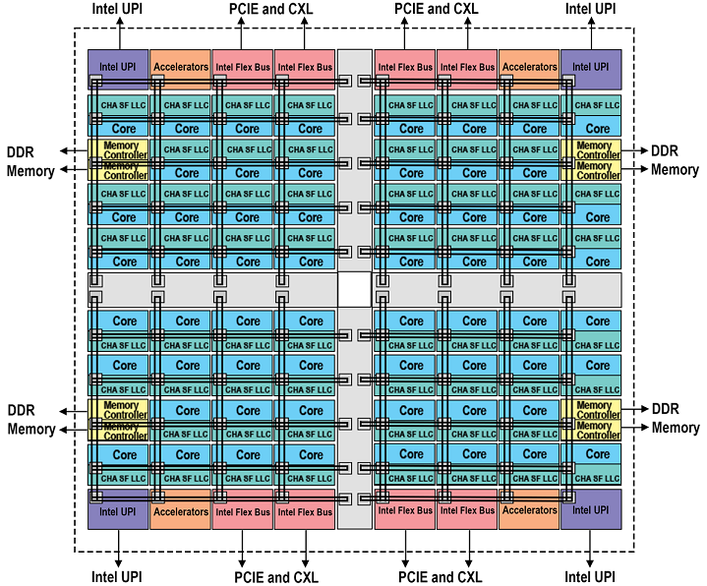
SOCs
What if you wanted something much more complex? Can SST simulate a core with SMT? What about something like a modern processor? SPR? EPYC?
https://www.intel.com/content/www/us/en/developer/articles/technical/fourth-generation-xeon-scalable-family-overview.html
https://www.amd.com/content/dam/amd/en/documents/epyc-technical-docs/white-papers/58015-epyc-9004-tg-architecture-overview.pdf

Slide 68
Single-core Vanadis
Let’s start simple…
RISC-V core
I-Cache
D-Cache
L2 Cache
Memory

Slide 69
Single-core Vanadis
What attributes can we change in the core model?
$ sst-info vanadis
Parameters (35 total)
verbose: Set the level of output verbosity, 0 is no output, higher is more output [0]
dbg_mask: Mask for output. Default is to not mask anything out (0) and defer to 'verbose'. [0]
start_verbose_when_issue_address: Set verbose to 0 until the specified instruction address is issued, then set to 'verbose' parameter []
stop_verbose_when_retire_address: When the specified instruction address is retired, set verbose to 0 []
pause_when_retire_address: If specified, the simulation will stop when this address is retired. [0]
pipeline_trace_file: If specified, a trace of the pipeline activity will be generated to this file. []
max_cycle: Maximum number of cycles to execute. The core will halt after this many cycles. [std::numeric_limits<uint64_t>::max()]
node_id: Identifier for the node this core belongs to. Each node in the system needs a unique ID between 0 and (number of nodes) - 1. Used to tag output. [0]
core_id: Identifier for this core. Each core in the system needs a unique ID between 0 and (number of cores) - 1. [<required>]
hardware_threads: Number of hardware threads in this core [1]
clock: Core clock frequency [1GHz]
reorder_slots: Number of slots in the reorder buffer [64]
physical_integer_registers: Number of physical integer registers per hardware thread [128]
physical_fp_registers: Number of physical floating point registers per hardware thread [128]
integer_arith_units: Number of integer arithemetic units [2]
integer_arith_cycles: Cycles per instruction for integer arithmetic [2]
integer_div_units: Number of integer division units [1]
integer_div_cycles: Cycles per instruction for integer division [4]
fp_arith_units: Number of floating point arithmetic units [2]
fp_arith_cycles: Cycles per floating point arithmetic [8]
fp_div_units: Number of floating point division units [1]
fp_div_cycles: Cycles per floating point division [80]
branch_units: Number of branch units [1]
branch_unit_cycles: Cycles per branch [int_arith_cycles]
issues_per_cycle: Number of instruction issues per cycle [2]
fetches_per_cycle: Number of instruction fetches per cycle [2]
retires_per_cycle: Number of instruction retires per cycle [2]
decodes_per_cycle: Number of instruction decodes per cycle [2]
dcache_line_width: Width of a line for the data cache, in bytes. (Currently not used but may be in the future). [64]
icache_line_width: Width of a line for the instruction cache, in bytes [64]
print_retire_tables: Print registers during retirement step (default is yes) [true]
print_issue_tables: Print registers during issue step (default is yes) [true]
print_int_reg: Print integer registers true/false, auto set to true if verbose > 16 [false]
print_fp_reg: Print floating-point registers true/false, auto set to true if verbose > 16 [false]
print_rob: Print reorder buffer state during issue and retire [true]

Slide 70
Single-core Vanadis
What attributes can we change in the core model?
$ sst-info vanadis
Default Parameter
Parameters (Purged a Few…)
clock: Core clock frequency [1GHz]
reorder_slots: Number of slots in the reorder buffer [64]
physical_integer_registers: Number of physical integer registers per hardware thread [128]
physical_fp_registers: Number of physical floating point registers per hardware thread [128]
integer_arith_units: Number of integer arithemetic units [2]
integer_arith_cycles: Cycles per instruction for integer arithmetic [2]
integer_div_units: Number of integer division units [1]
integer_div_cycles: Cycles per instruction for integer division [4]
fp_arith_units: Number of floating point arithmetic units [2]
fp_arith_cycles: Cycles per floating point arithmetic [8]
fp_div_units: Number of floating point division units [1]
fp_div_cycles: Cycles per floating point division [80]
branch_units: Number of branch units [1]
branch_unit_cycles: Cycles per branch [int_arith_cycles]
issues_per_cycle: Number of instruction issues per cycle [2]
fetches_per_cycle: Number of instruction fetches per cycle [2]
retires_per_cycle: Number of instruction retires per cycle [2]
decodes_per_cycle: Number of instruction decodes per cycle [2]

Slide 71
Single-core Vanadis
Let’s start simple…
Ok, not so simple but the structure is similar to all SST configurations
$ cat no_rtr_vanadis.py
$ sst no_rtr_vanadis.py

Slide 72
Multi-core Vanadis
What if we want to make something more complex?
3x2 mesh
CPUs at 1, 3, 4, 5
Memory at 0, 2

Slide 73
Multi-core Vanadis
What if we want to make something more complex?
This looks frightening but isn’t that bad…
$ cat boom_vanadis-kingsley.py
$ sst boom_vanadis-kingsley.py

Slide 74
Directions and Roadmap

Slide 75
SST Core Roadmap – Major Features
Continuous Sync - Threads
Continuous Sync - Rank
Hierarchical Partitioning
Current Feature
Continuous Sync
Prototype
Checkpointing
Profile Points
Work Started
Continuous Sync with Overdecomposition
Online Debugger
Not Started
Extended Profile Points
Cross Rank Load Balancing
Speculative Feature

Slide 76
SST Core Roadmap – Minor Features
  Better error messages during simulation build to make it easier for the user to debug input files
  Exceptions instead of fatal() calls during simulation initialization
  Parameter checking against ELI during input script execution
  Precise Statistics (accounting for simulation “overrun” during parallel simulations)
  Makes statistics consistent regardless of parallelization and sync interval
  Enables component initiated global statistics dump

Slide 77
SST Core Roadmap – Minor Features (2)
  Global Counters - Expanded version of primaryComponent API
  Use global counters as criteria for determining exit condition
    Example: For network simulation increment counter on message send and decrement on message receive and continue simulation until counter reaches zero
  Metis partitioner integration
  Misc. Features
  Realtime Heartbeats
  Templates for Components/SubComponents to use a starting point
  Improved verbose levels and masks for core output
  Speculative Features
  Supercomponent templates
  Parallel build on serial load

Slide 78
General Elements Roadmap
  Develop more python modules for element libraries
  This can help automate generation of common simulation structures
  Can help catch errors sooner in the simulation execution
  Library of Examples
  Repository or wiki to hold example simulations with all necessary inputs
  Workflow Examples
  Examples of workflow scripts to drive design studies and post-simulation data processing

Slide 79


Thanks!
Exceptional Service In The National Interest

Slide 80
Join Us!
We are always looking for new staff and new collaborations…
  Design challenges in the post-exascale era requires that we draw from a diverse pool of talent across multiple disciplines!
If you’re interested, check out https://www.sandia.gov/careers/career-possibilities/career-opportunities/computer-science/, or contact Clay at chughes@sandia.gov

Slide 81
Backup

Slide 82
Building Blocks
SST simulations are comprised of components connected by links
  Every link has a minimum (non-zero) latency
  Components define ports which are valid connection points for a link
Components communicate by sending events over the links
Components can use subcomponents and modules for customizable functionality
Component
Core
Link
Latency: 1ns
Component
Cache
Link
Latency: 2ns
Component
NoC Router
Event
Load
Event
Data
Element Library
A collection of components, subcomponents, and/or modules
SubComponent
Prefetcher
Link
Latency: 4ns
Component
Core
Link
Latency: 1ns
Component
Cache
Link
Latency: 2ns
Component
NoC Router

